Slide 1
E-Commerce
UNIT I

Slide 2
UNIT 1 : Introduction to E-commerce Syllabus
Overview:
E-commerce definition,
A Brief History,
Difference between E-commerce and E-business,
Types of E-commerce,
Unique Features of E-commerce Technology.
E-commerce Business Models and Concepts:
Key Elements of a Business Model,
Primary Revenue Models, Business Strategies.

Slide 3
Definition
Definition: generic
Buying and selling of Goods and Services using the Internet.
Text Book Definition:
Digitally enabled commercial transactions between and among organizations and individuals.

Slide 4
Introduction
Today, we are witnessing a new and vibrant social, mobile, and local model of e-commerce growing alongside the more traditional e-commerce retail sales model exemplified by Amazon.
Social network sites such as Facebook, Twitter, YouTube, and Pinterest, which enable users to distribute their own content (such as videos, music, photos, personal information, blogs, and software applications), have rocketed to prominence.
Spurred by the explosive growth in smartphones such as iPhones and Androids, tablet computers, and ultra-lightweight laptops, a new e-commerce platform has emerged called “social e-commerce” that is closely intertwined with social networks, mobile computing, and heretofore private social relationships.
Never before in the history of media have such large audiences been aggregated and made so accessible.

Slide 5
Introduction
Old methods for e-commerce:
Tele calling
TV ads
Selling on TV.. Etc.
In today's context electronic media refers to use of Internet.
Goods :Physical objects
eg: goods sold on Amazon, Flipkart
Services: Not Physical
eg: Netflix, AWS, Broadband, Cable connection.
Today e-commerce extensively makes use of web technologies, mobile computing, social media, cloud computing, data analytics, ML etc.

Slide 6
A Brief History
In 1994, e-commerce as we now know it did not exist.
The early years of e-commerce, during the late 1990s, were a period of business vision, inspiration, and experimentation.
Between 2002–2008, retail e-commerce grew at more than 25% per year. ( Desktop Based)
A mobile computing and communications platform based on smartphones and tablet computers (the “new client”) becomes a reality and begins to rival the PC platform.
A new app-based online economy grows alongside traditional Internet e-commerce, generating an estimated $25 billion in revenue worldwide in 2013.
By 2013–2014. Social networks have become a new e-commerce platform rivaling traditional e-commerce platforms by providing search, advertising, and payment services to vendors and customers.
Facebook continues to grow, with more than 1.1 billion active users worldwide.
Twitter continues to grow, with more than 200 million active users worldwide.

Slide 7
A Brief History
Computing and networking component prices continue to fall dramatically.
As firms track the trillions of online interactions that occur each day, a flood of data, typically referred to as “Big Data,” is being produced.
In order to make sense out of Big Data, firms turn to sophisticated software called business analytics (or Web analytics) that can identify purchase patterns as well as consumer interests and intentions in milliseconds.
Cloud computing completes the transformation of the mobile platform by storing consumer content and software on Internet servers and making it available to any consumer-connected device from the desktop to a smartphone.
E-books finally gain wide acceptance and today account for about half of all book sales.
Explosive growth continues in online and mobile viewing of video and television programs.
Invasion of personal privacy expands as marketers extend their capabilities to track users.

Slide 8
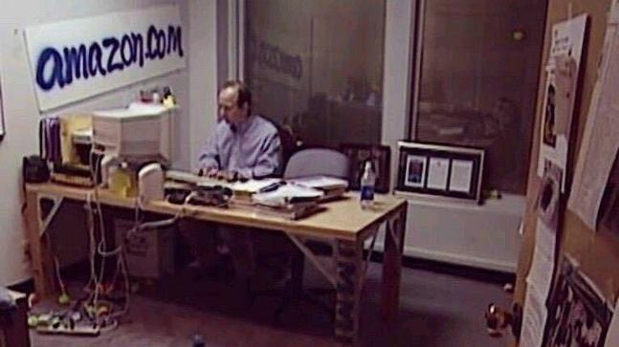
Amazon.com was started as an online bookstore by Jeffrey Preston Bezos in 1994 in his garage.

Slide 9
Amazon
Amazon.com was started as an online bookstore by Jeffrey Preston Bezos in 1994 in his garage, where he along with a few employees started developing the software for the site. Gradually they expanded their operations and moved from a garage to a two bedroom house.
Bezos launched the test site in July 1995 and received a phenomenal response upon the launch. Amazon shipped books across the United States and in 45 countries in just 30 days days of its launch-making it an instant hit.
following a two year-long successful inning Bezos took the company public.
In 2006, Amazon launched its on demand video service-Amazon Unbox. The following year, Amazon Kindle was released.
The next decade saw Amazon growing exponentially. Besides expanding Amazon's portfolio, Bezos added more crown jewels to his ever-diversifying interests.

Slide 10
Why Study E-commerce?
E-commerce is bringing fundamental changes to commerce
Traditional commerce:
Passive consumer and Sales-force driven:
Marketers viewed consumers as passive targets of advertising campaigns. The marketing and sale of goods was a mass-marketing and sales force–driven process.
Fixed prices:
Fixed prices due to Geographical and social boundaries, inability of customer to search widely for the best price and quality.
Information Asymmetry:
Any disparity in relevant market information among parties in a transaction. One of the shifts that e-commerce is bringing about is a reduction in information asymmetry among market participants (consumers and merchants). Preventing consumers from learning about costs, price discrimination strategies, and profits from sales becomes more difficult with e-commerce, and the entire marketplace potentially becomes highly price competitive.
In today's context, e-commerce technology is different, more powerful than previous technologies.

Slide 11
E-commerce vs. E-business
E-business:
Digital enablement of transactions and processes within a firm, involving information systems under firm’s control
Does not include commercial transactions involving an exchange of value across organizational boundaries.
For example, a company’s online inventory control mechanisms are a component of e-business, but such internal processes do not
directly generate revenue for the firm from outside businesses or consumers, as e-commerce.
However a firm’s e-business infrastructure provides support for online e-commerce exchanges.

Slide 12
Unique Features of E-commerce
Technology
1. Ubiquity
2. Global reach
3. Universal standards
4. Information richness
5. Interactivity
6. Information density
7. Personalization/customization
8. Social technology

Slide 13
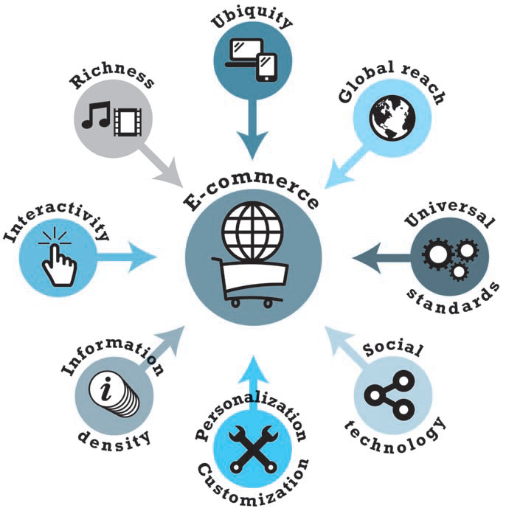

Slide 14
Ubiquity
In traditional commerce, a marketplace is a physical place you visit in order to transact. For example, television and radio typically motivate the consumer to go someplace to make a purchase.
E-commerce, in contrast, is characterized by its ubiquity it is available just about everywhere, at all times.
It liberates the market from being restricted to a physical space and makes it possible

Slide 15
Global Reach
E-commerce technology permits commercial transactions to cross cultural, regional, and national boundaries far more conveniently and cost-effectively than is true in traditional commerce.

Slide 16
Universal Standards
One strikingly unusual feature of e-commerce technologies is that the technical standards of the Internet, and therefore the technical standards for conducting e-commerce, are universal standards—they are shared by all nations around the world.

Slide 17
Richness
The Internet has the potential for offering considerably more information richness than traditional media such as printing presses, radio, and television because it is interactive and can adjust the message to individual users.

Slide 18
Interactivity
Unlike any of the commercial technologies of the twentieth century, with the possible exception of the telephone, e-commerce technologies allow for interactivity, meaning they enable two-way communication between merchant and consumer and among consumers.
Chatting with an online sales person, for instance, comes very close to the customer shopping experience in a retail shop.

Slide 19
Information Density
E-commerce technologies vastly increase information density—the total amount and quality of information available to all market participants, consumers, and merchants alike.
E-commerce technologies reduce information collection, storage, processing, and communication costs. At the same time, these technologies greatly increase the currency, accuracy, and timeliness of information—making information more useful and important than ever.
As a result, information becomes more plentiful, less expensive, and of higher quality.

Slide 20
Personalization and Customization
Personalization:
The targeting of marketing messages to specific individuals by adjusting the message to a person’s name, interests, and past purchases.
Customization:
Changing the delivered product or service based on a user’s preferences or prior behavior.

Slide 21
Social Technology
In a way quite different from all previous technologies, e-commerce technologies have evolved to be much more social by allowing users to create and share content with a worldwide community.
Users are able to create new social networks and strengthen existing ones.
The Internet provides a unique, many-to-many model of mass communication.

Slide 22
Types of E-Commerce
Classified by market relationship
Business-to-Consumer (B2C)
Business-to-Business (B2B)
Consumer-to-Consumer (C2C)
Classified by technology used
Peer-to-Peer (P2P)
Mobile commerce (M-commerce)

Slide 23
Types of E-Commerce
T Y P E O F E - C O M M E R CE
B2C—business-to-consumer
B2B—business-to-business
C2C—consumer-to-consumer
Social e-commerce
M-commerce—mobile e-commerce
Local e-commerce
E X A M P L E
Amazon is a general merchandiser that sells consumer products to retail consumers.
Go2Paper.com is an independent third-party marketplace that serves the paper industry.
On a large number of auction sites such as eBay, and listing sites such as Craigslist, consumers can auction or sell goods directly to
Face book is both the leading social network and social e-commerce site.
Mobile devices such as tablet computers and smart phones can be used to conduct commercial transactions.
Groupon offers subscribers daily deals from local businesses in the form of “Groupons,” discount coupons that take effect once enough subscribers have agreed to purchase.

Slide 24
